Slide 1
The Many Shades of Data Representation
AdHoc
Relational
Document markup
XML
JSON
NoSQL

Slide 2
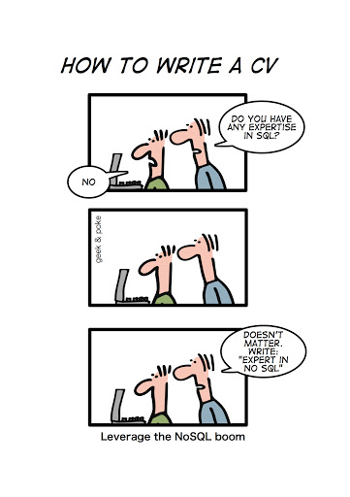
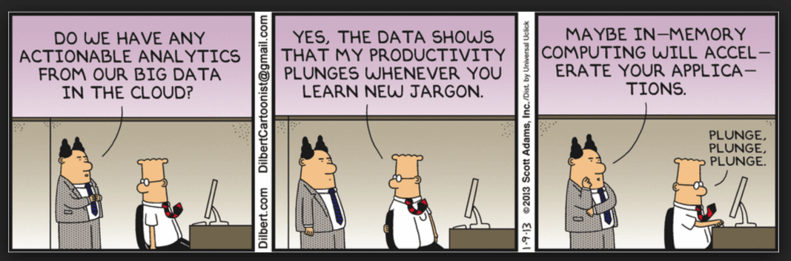
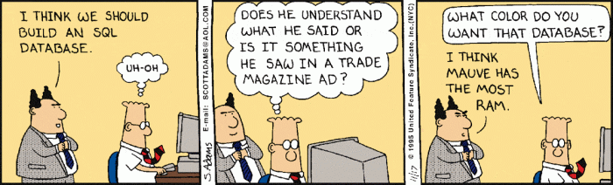

Slide 3
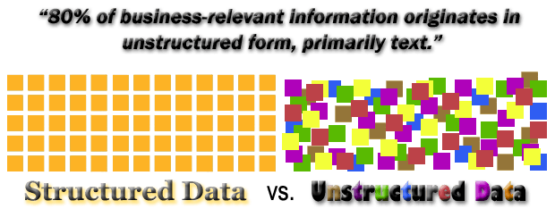
Source: https://www.bietltools.com/tag/whats-the-difference-of-structured-and-unstructured-data/

Slide 4
Types of Data
Data can be broadly classified into four types:
Structured Data:
Have a predefined model, which organizes data into a form that is relatively easy to store, process, retrieve and manage
E.g., relational data
Unstructured Data:
Opposite of structured data
E.g., Flat binary files containing text, video or audio
Note: data is not completely devoid of a structure (e.g., an audio file may still have an encoding structure and some metadata associated with it)

Slide 5
Types of Data
Data can be broadly classified into four types:
Dynamic Data:
Data that changes relatively frequently
E.g., transactional entries in a financial database, user generated data online (e.g., tweets), sensor collected data (e.g., weather and machinery)
Static Data:
Opposite of dynamic data
E.g., Medical imaging data from MRI or CT scans

Slide 6
Some Facts about Web x.0 and Big Data
Twitter: 350 million monthly active users and 500 million Tweets are sent per day,
Facebook: over 1 billion monthly users and faces 3 million message per 20 minute
Instagram: 200 Million Monthly Active Users and 1.6 Billion Likes and 60 Million Photos shared every day

Slide 7
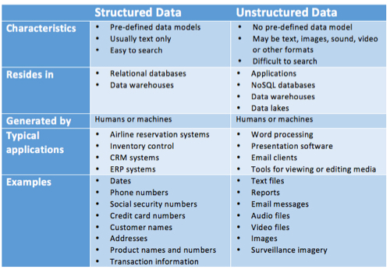
Not all data is structured
Source: https://www.datamation.com/big-data/structured-vs-unstructured-data.html

Slide 8
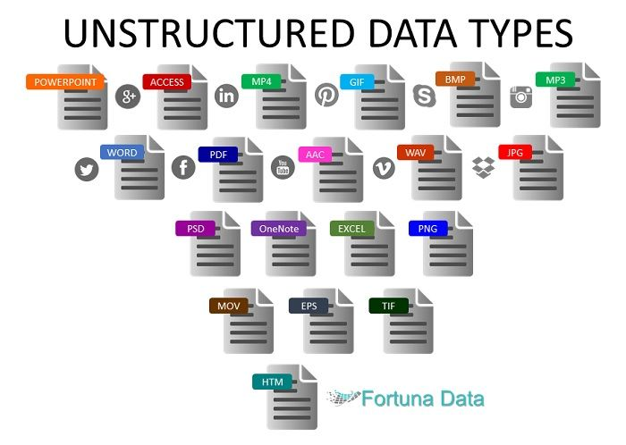

Slide 9

A Brief DB History
Early 1970s
Many database systems
Incompatible, exposing many implementation details
Then Ted Codd came along
Relational model
Structured Query Language (SQL)
Implementation differences became irrelevant
A few major DB systems dominated the market

Slide 10
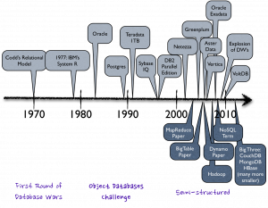
Database Evolution Timeline

Slide 11


















Database Systems Landscape Nowadays

Slide 12
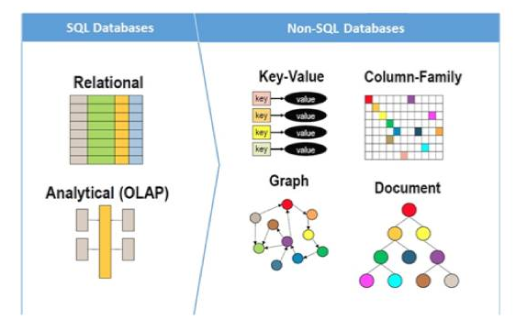
Somebody, Please, Bring Some Order to This Madness – Cont’d

Slide 13
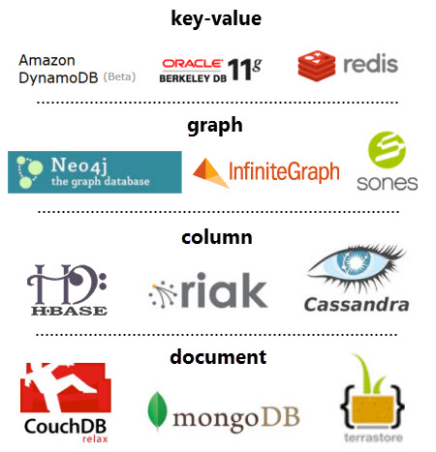
Somebody, Please, Bring Some Order to This Madness – Cont’d
NoSQL Data(base) Management Systems

Slide 14
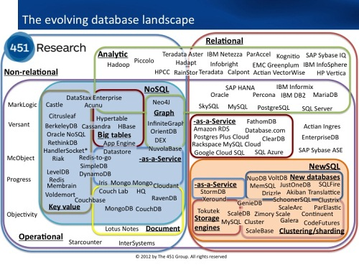
Somebody, Please, Bring Some Order to This Madness
Different Interfaces
Different hardware support
Different application support
Lack of Uniformity
Source: http://www.infoq.com/articles/State-of-NoSQL

Slide 15
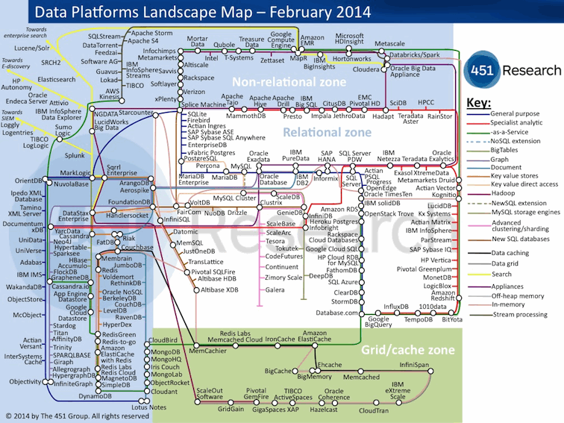

Slide 16
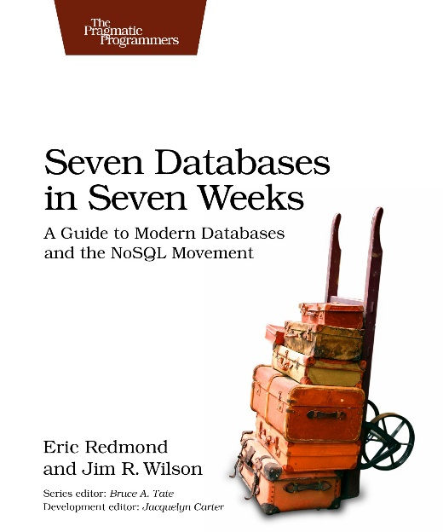
Additional Resources
Tutorial by C. Mohan, An In-Depth Look at Modern Database Systems
https://docs.google.com/file/d/0B7lNUaak0bK1encwYnBVUWZSWjA/edit
Seven Databases in Seven Weeks: A Guide to Modern Databases and the NoSQL Movement

Slide 17
Data Models
A collection of tools for describing
Data
Data relationships
Data semantics
Data constraints
Relational model
Entity-Relationship data model (mainly for database design)
Object-based data models (Object-oriented and Object-relational)
Semistructured data model (XML, JSON)
Graph Databases
based on the mathematical principle of graph theory.
Notes:
17

Slide 18
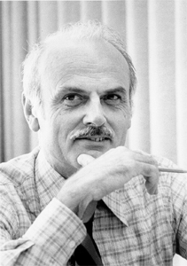
The Relational Data Model
It all began with a breakthrough paper by E.F. Codd in 1970:
“A relational model of data for large shared data banks”.
Communications of the ACM 13 (6): 377
Codd’s insights:
Separate physical implementation from logical
Model the data independently from how it will be used (accessed, printed, etc.)
Describe the data minimally and mathematically
Use standard mathematical (logical) operations over the data – these are the relational calculus (~ SQL) or relational algebra

Slide 19
What are Codd’s Basic Operations?
A relation is a set of tuples with the same schema
The relational algebra:
Select items from a set, based on a predicate
Project / map tuples based on a subset of their attributes
Join tuples from two relations based on a predicate over their relationships
Union tuples from two different sets
Group tuples by a subset of their fields, and compute an aggregate over the other fields

Slide 20
Optimization was key to adoption of relational systems
There was a gap between the breakthrough idea and commercial adoption
Codd’s original work: 1969-70
Earliest relational database research: ~1976
Oracle “2.0”: 1979
Key to success was optimization
Indexing
Optimization based on rewriting queries
Optimizing joins
“Materialized views” – precomputed, always-updated tables derived from others

Slide 21
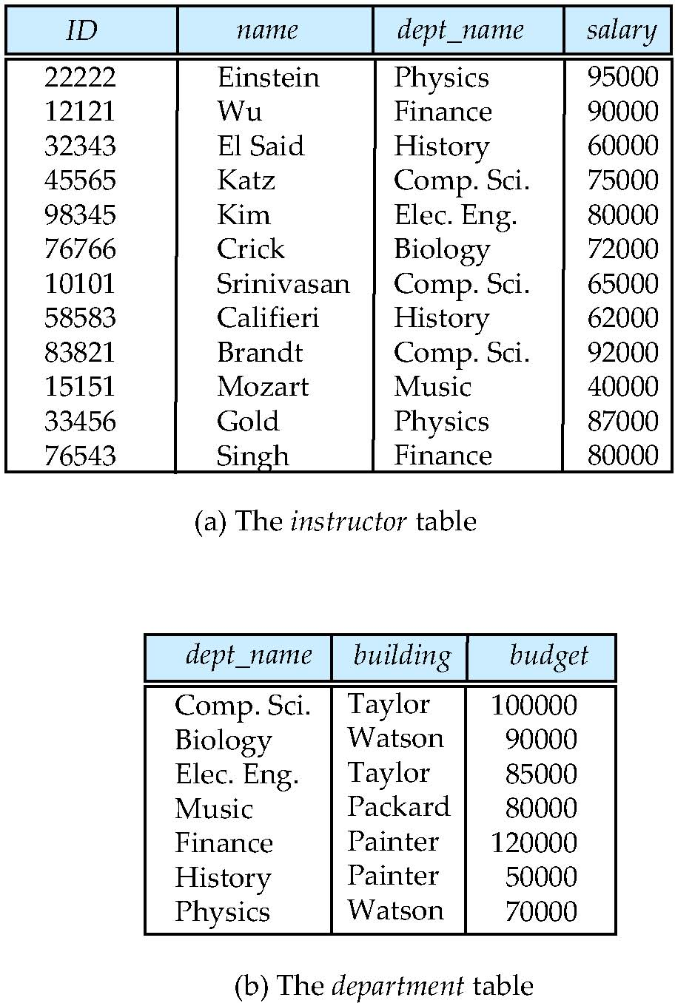
Relational Model
Example of tabular data in the relational model
Columns
Rows
Notes:
21

Slide 22
SQL
SQL: widely used non-procedural language
Example: Find the name of the instructor with ID 22222 select name from instructor where instructor.ID = ‘22222’
Example: Find the ID and building of instructors in the Physics dept.
select instructor.ID, department.building from instructor, department where instructor.dept_name = department.dept_name and department.dept_name = ‘Physics’
Application programs generally access databases through one of
Language extensions to allow embedded SQL
Application program interface (e.g., ODBC/JDBC) which allow SQL queries to be sent to a database
Notes:
22

Slide 23
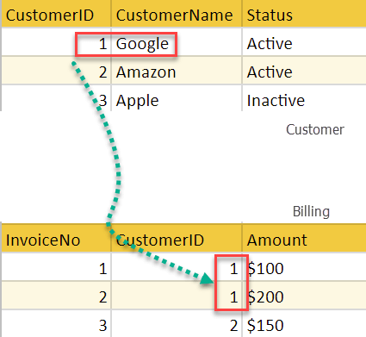
Integrity Constraints
On a Single Relation
not null
primary key
unique
check (P), where P is a predicate
On Multiple Relations
Referential Integrity
Ensures that a value that appears in one relation for a given set of attributes also appears for a certain set of attributes in another relation.

Slide 24
ACID Properties
A transaction is a unit of program execution that accesses and possibly updates various data items. To preserve the integrity of data the database system must ensure:
Atomicity. Either all operations of the transaction are properly reflected in the database or none are.
Consistency. Execution of a transaction in isolation preserves the consistency of the database.
Isolation. Although multiple transactions may execute concurrently, each transaction must be unaware of other concurrently executing transactions.
Durability. After a transaction completes successfully, the changes it has made to the database persist, even if there are system failures.

Slide 25
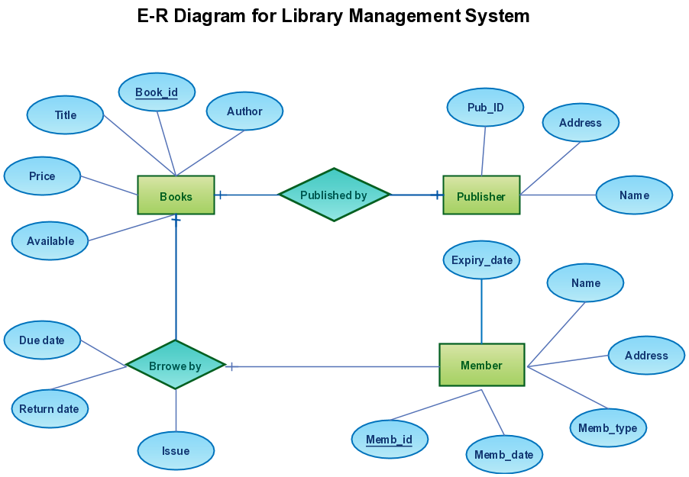
ER Model: Entities & Relationships

Slide 26
Introduction to XML
XML: Extensible Markup Language
Defined by the WWW Consortium (W3C)
Derived from SGML (Standard Generalized Markup Language), but simpler to use than SGML
Documents have tags giving extra information about sections of the document
E.g., <title> XML </title> <slide> Introduction …</slide>
Extensible, unlike HTML
Users can add new tags, and separately specify how the tag should be handled for display

Slide 27
XML Introduction (Cont.)
The ability to specify new tags, and to create nested tag structures make XML a great way to exchange data, not just documents.
Much of the use of XML has been in data exchange applications, not as a replacement for HTML
Tags make data (relatively) self-documenting
E.g., <university> <department> <dept_name> Comp. Sci. </dept_name> <building> Taylor </building> <budget> 100000 </budget> </department> <course> <course_id> CS-101 </course_id> <title> Intro. to Computer Science </title> <dept_name> Comp. Sci </dept_name> <credits> 4 </credits> </course>
</university>

Slide 28
XML: Motivation
Data interchange is critical in today’s networked world
Examples:
Banking: funds transfer
Order processing (especially inter-company orders)
Scientific data
Chemistry: ChemML, …
Genetics: BSML (Bio-Sequence Markup Language), …
Paper flow of information between organizations is being replaced by electronic flow of information
Each application area has its own set of standards for representing information
XML has become the basis for all new generation data interchange formats

Slide 29
XML Motivation (Cont.)
Earlier generation formats were based on plain text with line headers indicating the meaning of fields
Similar in concept to email headers
Does not allow for nested structures, no standard “type” language
Tied too closely to low level document structure (lines, spaces, etc)
Each XML based standard defines what are valid elements, using
XML type specification languages to specify the syntax
DTD (Document Type Descriptors)
XML Schema
Plus textual descriptions of the semantics
XML allows new tags to be defined as required
However, this may be constrained by DTDs
A wide variety of tools is available for parsing, browsing and querying XML documents/data

Slide 30
Comparison with Relational Data
Inefficient: tags, which in effect represent schema information, are repeated
Better than relational tuples as a data-exchange format
Unlike relational tuples, XML data is self-documenting due to presence of tags
Non-rigid format: tags can be added
Allows nested structures
Wide acceptance, not only in database systems, but also in browsers, tools, and applications

Slide 31
Structure of XML Data
Tag: label for a section of data
Element: section of data beginning with <tagname> and ending with matching </tagname>
Elements must be properly nested
Proper nesting
<course> … <title> …. </title> </course>
Improper nesting
<course> … <title> …. </course> </title>
Formally: every start tag must have a unique matching end tag, that is in the context of the same parent element.
Every document must have a single top-level element

Slide 32
Example of Nested Elements
<purchase_order> <identifier> P-101 </identifier> <purchaser> …. </purchaser> <itemlist> <item> <identifier> RS1 </identifier> <description> Atom powered rocket sled </description> <quantity> 2 </quantity> <price> 199.95 </price> </item> <item> <identifier> SG2 </identifier> <description> Superb glue </description> <quantity> 1 </quantity> <unit-of-measure> liter </unit-of-measure> <price> 29.95 </price> </item> </itemlist> </purchase_order>

Slide 33
Motivation for Nesting
Nesting of data is useful in data transfer
Example: elements representing item nested within an itemlist element
Nesting is not supported, or discouraged, in relational databases
With multiple orders, customer name and address are stored redundantly
Normalization replaces nested structures in each order by foreign key into table storing customer name and address information
But nesting is appropriate when transferring data
External application does not have direct access to data referenced by a foreign key

Slide 34
Structure of XML Data (Cont.)
Mixture of text with sub-elements is legal in XML.
Example:
<course> This course is being offered for the first time in 2009. <course id> BIO-399 </course id> <title> Computational Biology </title> <dept name> Biology </dept name> <credits> 3 </credits> </course>
Useful for document markup, but discouraged for data representation

Slide 35
Attributes
Elements can have attributes <course course_id= “CS-101”> <title> Intro. to Computer Science</title> <dept name> Comp. Sci. </dept name> <credits> 4 </credits> </course>
Attributes are specified by name=value pairs inside the starting tag of an element
An element may have several attributes, but each attribute name can only occur once
<course course_id = “CS-101” credits=“4”>

Slide 36
Attributes vs. Subelements
Distinction between subelement and attribute
In the context of documents, attributes are part of markup, while subelement contents are part of the basic document contents
In the context of data representation, the difference is unclear and may be confusing
Same information can be represented in two ways
<course course_id= “CS-101”> … </course>
<course> <course_id>CS-101</course_id> … </course>
Suggestion: use attributes for identifiers of elements, and use subelements for contents

Slide 37
More on XML Syntax
Elements without subelements or text content can be abbreviated by ending the start tag with a /> and deleting the end tag
<course course_id=“CS-101” Title=“Intro. To Computer Science” dept_name = “Comp. Sci.” credits=“4” />
To store string data that may contain tags, without the tags being interpreted as subelements, use CDATA as below
<![CDATA[<course> … </course>]]>
Here, <course> and </course> are treated as just strings
CDATA stands for “character data”

Slide 38
XML Document Schema
Database schemas constrain what information can be stored, and the data types of stored values
XML documents are not required to have an associated schema
However, schemas are very important for XML data exchange
Otherwise, a site cannot automatically interpret data received from another site
Two mechanisms for specifying XML schema
Document Type Definition (DTD)
Widely used
XML Schema
Newer, increasing use

Slide 39
Document Type Definition (DTD)
The type of an XML document can be specified using a DTD
DTD constraints structure of XML data
What elements can occur
What attributes can/must an element have
What subelements can/must occur inside each element, and how many times.
DTD does not constrain data types
All values represented as strings in XML
DTD syntax
<!ELEMENT element (subelements-specification) >
<!ATTLIST element (attributes) >

Slide 40
Element Specification in DTD
Subelements can be specified as
names of elements, or
#PCDATA (parsed character data), i.e., character strings
EMPTY (no subelements) or ANY (anything can be a subelement)
Example
<! ELEMENT department (dept_name building, budget)>
<! ELEMENT dept_name (#PCDATA)>
<! ELEMENT budget (#PCDATA)>
Subelement specification may have regular expressions
<!ELEMENT university ( ( department | course | instructor | teaches )+)>
Notation:
“|” - alternatives
“+” - 1 or more occurrences
“*” - 0 or more occurrences

Slide 41
University DTD
<!DOCTYPE university [ <!ELEMENT university ( (department|course|instructor|teaches)+)> <!ELEMENT department ( dept name, building, budget)> <!ELEMENT course ( course id, title, dept name, credits)> <!ELEMENT instructor (IID, name, dept name, salary)> <!ELEMENT teaches (IID, course id)> <!ELEMENT dept name( #PCDATA )> <!ELEMENT building( #PCDATA )> <!ELEMENT budget( #PCDATA )> <!ELEMENT course id ( #PCDATA )> <!ELEMENT title ( #PCDATA )> <!ELEMENT credits( #PCDATA )> <!ELEMENT IID( #PCDATA )> <!ELEMENT name( #PCDATA )> <!ELEMENT salary( #PCDATA )>
]>

Slide 42
Attribute Specification in DTD
Attribute specification : for each attribute
Name
Type of attribute
CDATA
ID (identifier) or IDREF (ID reference) or IDREFS (multiple IDREFs)
more on this later
Whether
mandatory (#REQUIRED)
has a default value (value),
or neither (#IMPLIED)
Examples
<!ATTLIST course course_id CDATA #REQUIRED>, or
<!ATTLIST course
course_id ID #REQUIRED
dept_name IDREF #REQUIRED
instructors IDREFS #IMPLIED >

Slide 43
IDs and IDREFs
An element can have at most one attribute of type ID
The ID attribute value of each element in an XML document must be distinct
Thus the ID attribute value is an object identifier
An attribute of type IDREF must contain the ID value of an element in the same document
An attribute of type IDREFS contains a set of (0 or more) ID values. Each ID value must contain the ID value of an element in the same document

Slide 44
University DTD with Attributes
University DTD with ID and IDREF attribute types. <!DOCTYPE university-3 [ <!ELEMENT university ( (department|course|instructor)+)> <!ELEMENT department ( building, budget )> <!ATTLIST department dept_name ID #REQUIRED > <!ELEMENT course (title, credits )> <!ATTLIST course course_id ID #REQUIRED dept_name IDREF #REQUIRED instructors IDREFS #IMPLIED > <!ELEMENT instructor ( name, salary )> <!ATTLIST instructor IID ID #REQUIRED dept_name IDREF #REQUIRED > · · · declarations for title, credits, building, budget, name and salary · · · ]>

Slide 45
XML data with ID and IDREF attributes
<university-3>
<department dept name=“Comp. Sci.”>
<building> Taylor </building>
<budget> 100000 </budget>
</department>
<department dept name=“Biology”>
<building> Watson </building>
<budget> 90000 </budget>
</department>
<course course id=“CS-101” dept name=“Comp. Sci”
instructors=“10101 83821”>
<title> Intro. to Computer Science </title>
<credits> 4 </credits>
</course>
….
<instructor IID=“10101” dept name=“Comp. Sci.”>
<name> Srinivasan </name>
<salary> 65000 </salary>
</instructor>
….
</university-3>

Slide 46
Limitations of DTDs
No typing of text elements and attributes
All values are strings, no integers, reals, etc.
Difficult to specify unordered sets of subelements
Order is usually irrelevant in databases (unlike in the document-layout environment from which XML evolved)
(A | B)* allows specification of an unordered set, but
Cannot ensure that each of A and B occurs only once
IDs and IDREFs are untyped
The instructors attribute of a course may contain a reference to another course, which is meaningless
instructors attribute should ideally be constrained to refer to instructor elements

Slide 47
XML Schema
XML Schema is a more sophisticated schema language which addresses the drawbacks of DTDs. Supports
Typing of values
E.g., integer, string, etc
Also, constraints on min/max values
User-defined, comlex types
Many more features, including
uniqueness and foreign key constraints, inheritance
XML Schema is itself specified in XML syntax, unlike DTDs
More-standard representation, but verbose
XML Scheme is integrated with namespaces
BUT: XML Schema is significantly more complicated than DTDs.

Slide 48
Querying and Transforming XML Data
Translation of information from one XML schema to another
Querying on XML data
Above two are closely related, and handled by the same tools
Standard XML querying/translation languages
XPath
Simple language consisting of path expressions
XSLT
Simple language designed for translation from XML to XML and XML to HTML
XQuery
An XML query language with a rich set of features

Slide 49
Tree Model of XML Data
Query and transformation languages are based on a tree model of XML data
An XML document is modeled as a tree, with nodes corresponding to elements and attributes
Element nodes have child nodes, which can be attributes or subelements
Text in an element is modeled as a text node child of the element
Children of a node are ordered according to their order in the XML document
Element and attribute nodes (except for the root node) have a single parent, which is an element node
The root node has a single child, which is the root element of the document

Slide 50
XQuery
XQuery is a general purpose query language for XML data
Currently being standardized by the World Wide Web Consortium (W3C)
XQuery is derived from the Quilt query language, which itself borrows from SQL, XQL and XML-QL
XQuery uses a for … let … where … order by …result … syntax for ⬄ SQL from where ⬄ SQL where order by ⬄ SQL order by
result ⬄ SQL select let allows temporary variables, and has no equivalent in SQL

Slide 51
FLWOR Syntax in XQuery
For clause uses XPath expressions, and variable in for clause ranges over values in the set returned by XPath
Simple FLWOR expression in XQuery
find all courses with credits > 3, with each result enclosed in an <course_id> .. </course_id> tag for $x in /university-3/course let $courseId := $x/@course_id where $x/credits > 3 return <course_id> { $courseId } </course id>
Items in the return clause are XML text unless enclosed in {}, in which case they are evaluated
Let clause not really needed in this query. Query can be written as:
for $x in /university-3/course[credits > 3] return <course_id> { $x/@course_id } </course_id>
Alternative notation for constructing elements:
return element course_id { element $x/@course_id }

Slide 52
Joins
Joins are specified in a manner very similar to SQL
for $c in /university/course, $i in /university/instructor, $t in /university/teaches where $c/course_id= $t/course id and $t/IID = $i/IID return <course_instructor> { $c $i } </course_instructor>

Slide 53
Application Program Interface
There are two standard application program interfaces to XML data:
SAX (Simple API for XML)
Based on parser model, user provides event handlers for parsing events
E.g., start of element, end of element
DOM (Document Object Model)
XML data is parsed into a tree representation
Variety of functions provided for traversing the DOM tree
E.g.: Java DOM API provides Node class with methods getParentNode( ), getFirstChild( ), getNextSibling( ) getAttribute( ), getData( ) (for text node) getElementsByTagName( ), …
Also provides functions for updating DOM tree

Slide 54
Storage of XML in Relational Databases
Alternatives:
String Representation
Tree Representation
Map to relations
All major Relational DBMSes support XML
MS SQL Server, Oracle, IBM DB2.

Slide 55
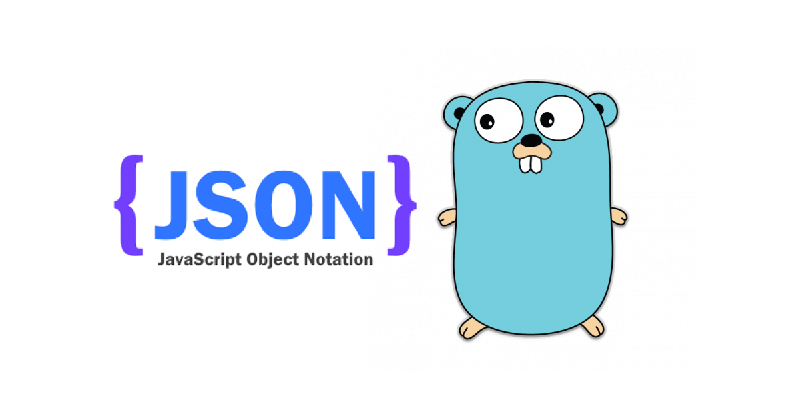

Slide 56
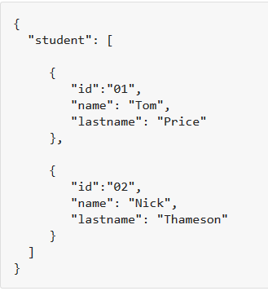
Example
{ "student": [ { "id":"01", "name": "Tom", "lastname": "Price" }, { "id":"02", "name": "Nick", "lastname": "Thameson" } ] }

Slide 57
Data Interchange
The key idea in Ajax.
An alternative to page replacement.
Applications delivered as pages.
How should the data be delivered?

Slide 58
JSON: Goals
A Subset of ECMA-262 Third Edition.
Language Independent.
Text-based.
Light-weight.
Easy to parse.

Slide 59
JSON Is Not...
JSON is not a document format.
JSON is not a markup language.
JSON is not a general serialization format.
No cyclical/recurring structures.
No invisible structures.
No functions.

Slide 60
Its Key Ingredients
Strings
Numbers
Booleans
Objects
Arrays
null

Slide 61
Strings
Sequence of 0 or more Unicode characters
No separate character type
A character is represented as a string with a length of 1
Wrapped in "double quotes"
Backslash escapement

Slide 62
Numbers
Integer
Real
Scientific
No octal or hex
No NaN or Infinity
Use null instead

Slide 63
Booleans
true
false

Slide 64
null
A value that isn't anything

Slide 65
Object
Objects are unordered containers of key/value pairs
Objects are wrapped in { }
, separates key/value pairs
: separates keys and values
Keys are strings
Values are JSON values
struct, record, hashtable, object

Slide 66
Object
{"name":"Jack B. Nimble","at large": true,"grade":"A","level":3, "format":{"type":"rect","width":1920, "height":1080,"interlace":false, "framerate":24}}

Slide 67
Object
{
"name": "Jack B. Nimble",
"at large": true,
"grade": "A",
"format": {
"type": "rect",
"width": 1920,
"height": 1080,
"interlace": false,
"framerate": 24
}
}

Slide 68
Array
Arrays are ordered sequences of values
Arrays are wrapped in []
, separates values
JSON does not talk about indexing.
An implementation can start array indexing at 0 or 1.

Slide 69
Array
["Sunday", "Monday", "Tuesday", "Wednesday", "Thursday", "Friday", "Saturday"]
[
[0, -1, 0],
[1, 0, 0],
[0, 0, 1]
]

Slide 70
Arrays vs Objects
Use objects when the key names are arbitrary strings.
Use arrays when the key names are sequential integers.
Don't get confused by the term Associative Array.

Slide 71
Arguments against JSON
JSON Doesn't Have Namespaces.
JSON Has No Validator.
JSON Is Not Extensible.
JSON Is Not XML.

Slide 72
JSON Is Not XML
objects
arrays
strings
numbers
booleans
null
element
attribute
attribute string
content
<![CDATA[ ]]>
entities
declarations
schema
stylesheets
comments
version
namespace

Slide 73
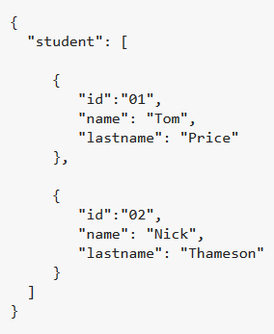
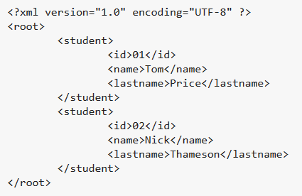
<XML/> vs. {JSON}

Slide 74
Data Interchange
JSON is a simple, common representation of data.
Communication between servers and browser clients.
Communication between peers.
Language independent data interchange.

Slide 75
Working with Data at Scale

Slide 76
Scaling Traditional Databases
Traditional RDBMSs can be either scaled:
Vertically (or Up)
Can be achieved by hardware upgrades (e.g., faster CPU, more memory, or larger disk)
Limited by the amount of CPU, RAM and disk that can be configured on a single machine
Horizontally (or Out)
Can be achieved by adding more machines
Requires database sharding and probably replication
Limited by the Read-to-Write ratio and communication overhead

Slide 77
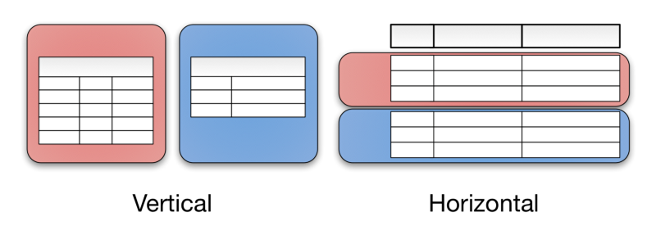
Vertical vs. Horizontal Partitioning

Slide 78

Why Replicating Data?
Replicating data across servers helps in:
Avoiding performance bottlenecks
Avoiding single point of failures
And, hence, enhancing scalability and availability
Google Server
Replicated Servers

Slide 79
Sharding
Starts with ‘A’-’D’ | Server 1
Starts with ‘E’-’Q’ | Server 2
Starts with ‘R’-’T’ | Server 3
Starts with ‘U’-’Z’ | Server 4
Starts with anything else | Server 5
Sharding is a method of splitting and storing a single logical dataset in multiple databases.
What if we want to uniformly distribute the placement of data but make it predictable?

Slide 80
Hashing “Spreads out” the Values into Predictable Locations
For a “good” hash function:
Given numbers x and y, x ≠ y
h(x) and h(y) are extremely unlikely to be equal
often: changing one bit in input causes ~50% of bits to change in output
A-C | apple avacado
D-F
G-L
M-Q
R-S | rooster runway
T-V | tire tourist turtle
W-Z
other
0-99 | tire
100-199 | apple
200-299 | rooster
300-399 | avacado
400-499
500-599 | tire
600-699
700-799 | runway
800-899
900-999 | tourist
hash function
h(x)
h(’apple’) = 70
h(‘avacado’) = 324
h(‘tire’) = 501
h(‘tourist’) = 980

Slide 81
Consistency Becomes a Challenge
An example:
In an e-commerce application, the bank database has been replicated across two servers
Maintaining consistency of replicated data is a challenge
Event 1 = Add $1000
Event 2 = Add interest of 5%
1
2
Bal=2000
4
Bal=2100
Bal=1000
3
Bal=1000
Bal=1050
Bal=2050
Replicated Database

Slide 82
The CAP Theorem
The limitations of distributed databases can be described in the so called CAP theorem
Consistency: every node always sees the same data at any given instance (i.e., strict consistency)
Availability: the system continues to operate, even if nodes in a cluster crash, or some hardware or software parts are down due to upgrades
Partition Tolerance: the system continues to operate in the presence of network partitions
CAP theorem: any distributed database with shared data, can have at most two of the three desirable properties, C, A or P

Slide 83
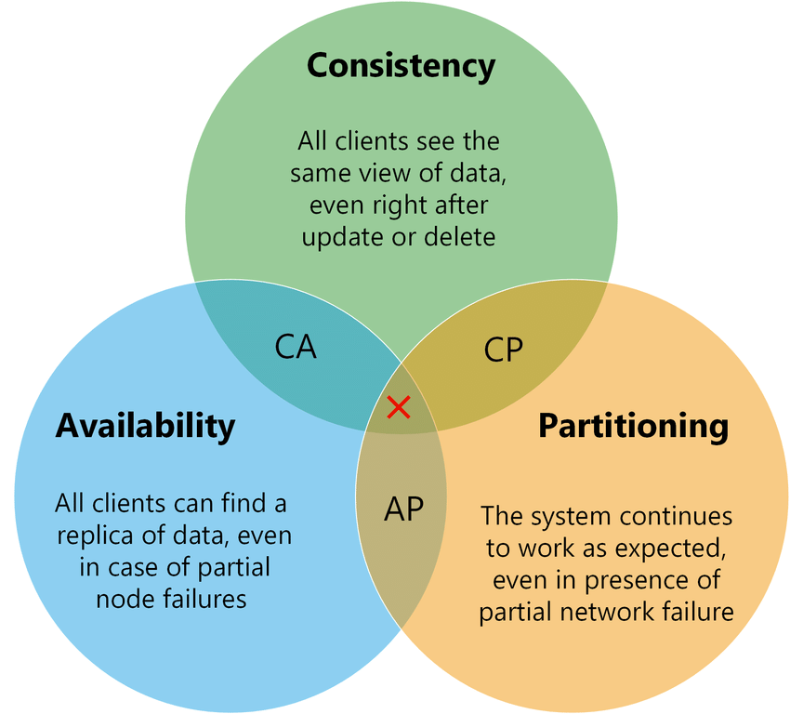
Simply put, the CAP theorem demonstrates that any distributed system cannot guaranty C, A, and P simultaneously, rather, trade-offs must be made at a point-in-time to achieve the level of performance and availability required for a specific task.

Slide 84
Large-Scale Databases
For companies like Google and Amazon with large-scale databases, 24/7 Availability is key
A few minutes of downtime means lost revenue
When horizontally scaling databases to 1000s of machines, the likelihood of a node or a network failure increases tremendously
Recall MTTF?
Therefore, in order to have strong guarantees on Availability and Partition Tolerance, they have to sacrifice “strict” Consistency (implied by the CAP theorem)

Slide 85
Trading-Off Consistency
Maintaining consistency should balance between the strictness of consistency versus availability/scalability
Good-enough consistency depends on your application
Loose Consistency
Strict Consistency
Easier to implement, and is efficient
Generally hard to implement, and is inefficient

Slide 86
The BASE Properties
The CAP theorem proves that it is impossible to guarantee strict Consistency and Availability while being able to tolerate network partitions
Emergence of databases with relaxed ACID guarantees
In particular, such databases apply the BASE properties:
Basically Available: the system guarantees Availability
Soft-State: the state of the system may change over time
Eventual Consistency: the system will eventually become consistent

Slide 87
Eventual Consistency
A database is termed as Eventually Consistent if:
All replicas will gradually become consistent in the absence of updates

Slide 88
Eventual Consistency
A database is termed as Eventually Consistent if:
All replicas will gradually become consistent in the absence of updates
Webpage-A
Webpage-A
Webpage-A
Webpage-A
Webpage-A
Webpage-A
Event: Update Webpage-A
Webpage-A
Webpage-A
Webpage-A
Webpage-A
Webpage-A
Webpage-A

Slide 89
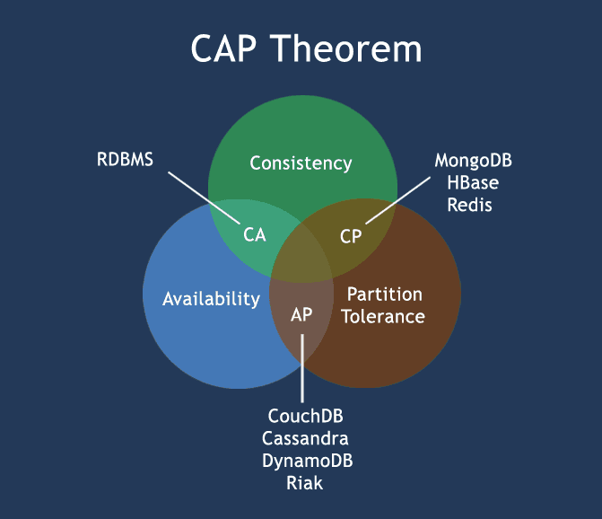
Data Intensive DBMS’s

Slide 90
NoSQL Databases
To this end, a new class of databases emerged, which mainly follow the BASE properties
These were dubbed as NoSQL databases
E.g., Amazon’s Dynamo and Google’s Bigtable
Main characteristics of NoSQL databases include:
No strict schema requirements
No strict adherence to ACID properties
Consistency is traded in favor of Availability

Slide 91
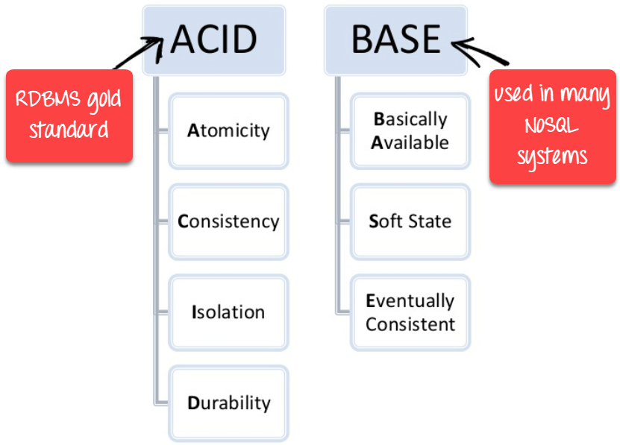

Slide 92
Document Stores
Documents are stored in some standard format or encoding (e.g., XML, JSON, PDF or Office Documents)
These are typically referred to as Binary Large Objects (BLOBs)
Documents can be indexed
This allows document stores to outperform traditional file systems
E.g., MongoDB and CouchDB (both can be queried using MapReduce)

Slide 93


SQL
MongoDB
START TRANSACTION;
INSERT INTO contacts VALUES
(NULL, ‘joeblow’);
INSERT INTO contact_emails VALUES
( NULL, ”joe@blow.com”,
LAST_INSERT_ID() ),
( NULL, “joseph@blow.com”,
LAST_INSERT_ID() );
COMMIT;
db.contacts.save( {
userName: “joeblow”,
emailAddresses: [
“joe@blow.com”,
“joseph@blow.com” ] } );

Slide 94

Document Stores
MongoDB does not need any pre-defined data schema
Every document could have different data!
{name: “will”,
eyes: “blue”,
birthplace: “NY”,
aliases: [“bill”, “la ciacco”],
loc: [32.7, 63.4],
boss: ”ben”}
{name: “jeff”,
eyes: “blue”,
loc: [40.7, 73.4],
boss: “ben”}
{name: “brendan”,
aliases: [“el diablo”]}
{name: “matt”,
pizza: “DiGiorno”,
height: 72,
loc: [44.6, 71.3]}
{name: “ben”,
hat: ”yes”}
Notes:
Applications enforce the data “schema” and integrity, much like MUMPS does in VistA

